Slide 1



National Advocacy Service for people with disabilities (NAS)
Mary CarrolL
Senior Advocate

Slide 2
Overview
About the National Advocacy Service for People with Disabilities
Basis of Advocacy
Social Policy Focus for NAS
Decision-making and Assisted Decision Making (Capacity) Act
The role of advocates and impact of ADMA on NAS

Slide 3

About the National Advocacy Service
Established 2005 as pilot projects, national company since 2014
Funded and supported by the Citizens Information Board
CIB statutory obligation to provide advocacy and a representative advocacy service for people with disabilities (Comhairle Act 2000 & Citizens Info Act 2007)
Fully professional, independent, free and confidential service
50 paid, professional staff across Ireland
NAS also launched and hosts the Patient Advocacy Service which has been in operation since October 2019

Slide 4







Our Family Tree…

Slide 5
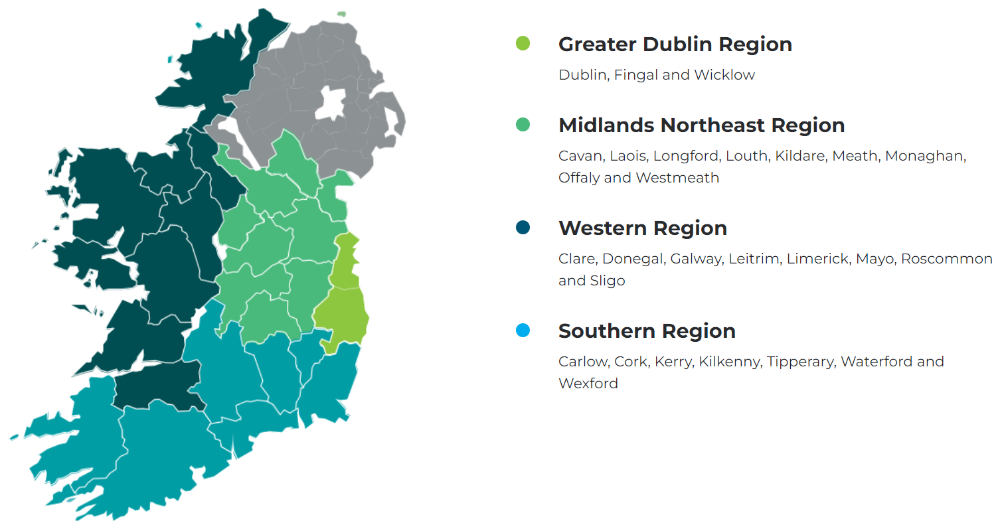

Where NAS operates:

Slide 6
The basis for advocacy
Citizens Information Act 2007 – not fully commenced
Health Act – Regulations for older persons designated centres
ADMA – Code for independent advocates
HSE consent policy and national safeguarding policy
Wasted lives report – Ombudsman
Ratification of the UNCRPD

Slide 7

About the National Advocacy Service
NAS has a particular remit for adults (18+) with disabilities who:
• Live in the community & are isolated from their community and services.
• Have communication differences.
• Are inappropriately accommodated.
• Live in residential services.
• Attend day services.
• Have limited informal or natural supports.

Slide 8
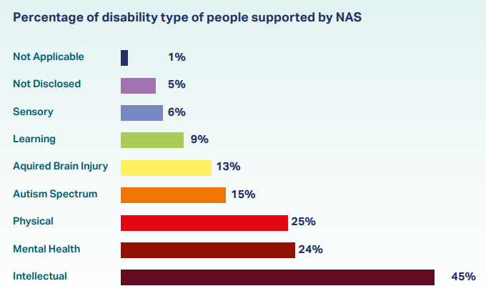
Those NAS Supports (2023)

Slide 9
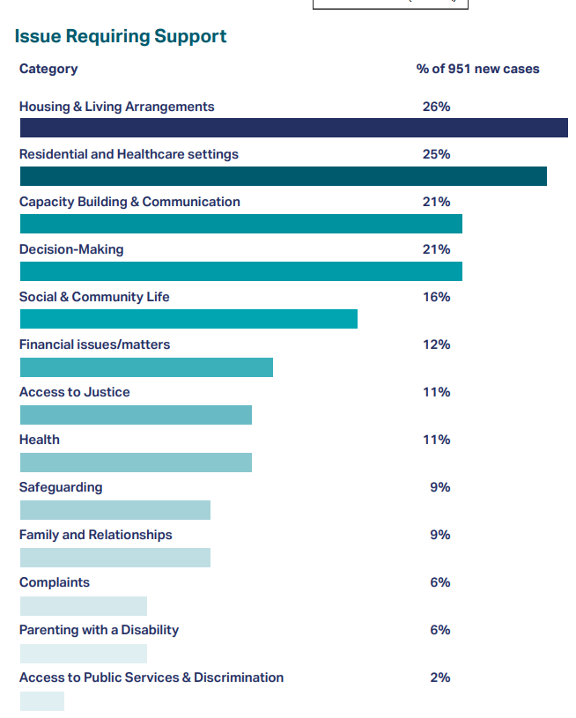

Slide 10
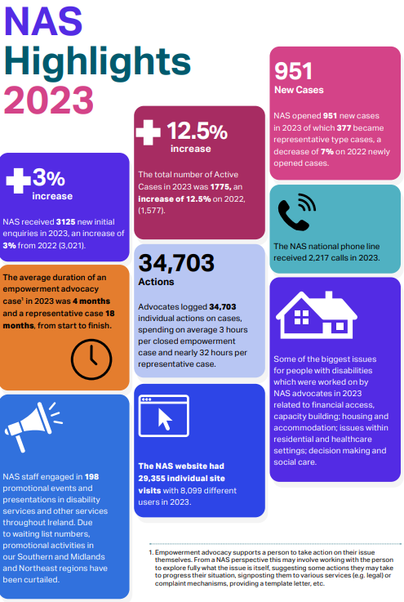
Key Highlights
(2023)

Slide 11
NAS Advocacy code of practice: upholding Will and Preference
The role of the advocate is to get to know the person and support them to have their wishes, will and preferences kept at the centre of the decision making process.
Advocates support the person to be directly involved in decision-making processes which affect them and must aim to present information in ways that assist the person to make their own informed decisions and choices. (Advocates are never decision makers for the person)
Advocates work to support a person’s right to take considered risks and experience failure.
Advocates must not be influenced or compromised in carrying out their role by any other party and cannot do anything the person does not want them to do.
Advocates adopt a ‘Will and Preference’ V ‘Best Interests’ approach.
Notes:
NAS code of practice embodies the principles of the ADM (Capacity) Act. Here are some excerpts from that code that demonstrates how advocates work to uphold peoples will and preference.

Slide 12

Things an Advocate will not do
Tell the person what to do
Tell the person what decisions to make
Make decisions on the person’s behalf
Give legal advice
Act without the person’s permission

Slide 13
Enquiry Examples
A staff member contacts NAS in support of a person when a conflict of interest exists between a service and a person’s family. As a result the person’s will and preference is getting lost.
A young person placed in a nursing home contacts NAS as there is no plan in place for them to exit this setting and they do not have a contact person to progress this matter. The person is very unhappy where they are living.
A person contacts NAS as they want to move from a congregated setting to live in the community in a place of their choosing.
A person contacts NAS as they have concerns that they don’t have control over their money.

Slide 14
Case Example:
Susan

Slide 15
NAS Casework - Susan
Susan communicates differently, but had some verbal words
She was referred to NAS as her parents were getting older and her social worker, alongside her day service were recommending moving her to a residential service.
A key worker referred Susan into NAS as she was concerned, Susan wasn’t being consulted.
NAS advocate met with Susan and noticed she was distressed when mention of a move came about and requested that a move be postponed.
The advocate spent time with her and got to know her over many months.
The advocate regularly provided updates to the MDT regarding Susan, at her request.
Eventually it was agreed that a two-month trial would take place in residential service, with Susan’s agreement.

Slide 16
NAS Casework - Susan
The advocate regularly met Susan during the trial period in her temporary home.
Through the “4 approaches” work with Susan it was clear she was not happy and wanted to return home.
The advocate communicated this, and suggested alternative supports.
It was agreed that monthly respite and weekly home help hours would ensure Susan got to stay in her family home where she was happy.
Advocacy intervention ensured will and preference was acknowledged and then adhered too.

Slide 17
Human Rights vs Safeguarding
The need to ensure both
Case example
John

Slide 18
NAS Casework - John
John has always had access to his bank account. He always had autonomy over his choices.
He was encouraged by his residential service provider to open an account where they would receive his money and load an amount onto a debit card.
The service decided a set amount to be given per week on this card and John had to make an application whenever he wanted additional money.
This removed his autonomy, added scrutiny over his life choices and ensured he did not have the same access to money as before.

Slide 19
NAS Casework - John
Was this in-keeping with the persons human rights?

Slide 20
Something to remember
“What good is it making someone safer, if it merely makes them miserable?”
Justice Munby in Re: MM [2007] EWHC 2003 (Fam)

Slide 21
Addressing systemic issues
Notes:
Caveat – not a systemic advocacy based service – but note the reason for the focus.

Slide 22


NAS Focus on Social Policy issue 2023/2024
1:1 Advocacy work with individuals
Spotlight issue in NAS Casebook 2023
‘My Money, My Rights, My Options’ easy-to-read booklet
NAS Presentation to Consumer Advisory Group Central Bank
Participation in Banking Roundtable
Social Policy Paper
#NAShortchanged

Slide 23
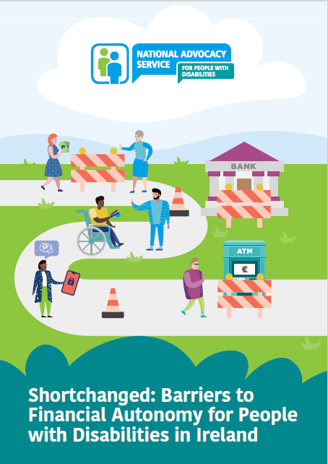
NAS SOCIAL POLICY PAPER
#NAShortchanged

Slide 24

Key Findings
Discrimination on the grounds of disability
Digital Exclusion
Focus on people with disabilities as ‘vulnerable’ customers rather than citizens with rights
Third party control and restriction of people’s money
Financial Abuse
#NAShortchanged

Slide 25

1. Financial Services Issues
Training for staff in Financial Services on ADM (Capacity) Act
Consultation with people with disabilities in development of new banking technology
Regular reviews of accessibility by Financial Services to look at literature, websites and phone lines
Need to identify a range of identification formats
Change in the language used by Financial Services in how they refer to people with disabilities
#NAShortchanged

Slide 26

2. Third Party Control Of Finances
Build financial capacity
Organisations should build awareness about people’s financial rights
The Department of Social Protection - robust reviews of agent arrangements
The Health Act 2007 (Regulations 2013) need to be updated
#NAShortchanged

Slide 27


3. Responses To Financial Abuse Of People With Disabilities
Legislation to underpin the work of Safeguarding and Protection Teams
Consistent approach on role of Designated Officers for safeguarding
HSE Safeguarding and Protection Teams need to be adequately resourced
Independent Advocacy should be a key priority in the programme for Government
Independent oversight of structures and systems of safeguarding practices in Ireland
#NAShortchanged

Slide 28

4. Managing Finances In Disability Service Settings
Disability services could play a more proactive role in awareness raising campaigns
More Staff training initiatives on supporting financial autonomy
Health Act regulations for Long Term Care settings should be reviewed to enable greater focus on financial issues in services.
Services must ensure that individualised person-centred financial support plans are put in place for each person.
#NAShortchanged

Slide 29

5. Discrimination And Equality Issues
Adherence to the Assisted Decision-Making (Capacity) Act
Financial institutions must ensure compliance with the Equal Status Act, the ADMCA and the Public Sector Duty (Irish Human Rights and Equality Commission Act 2014)
#NAShortchanged

Slide 30
Outcomes as a result of policy launch
Central Bank of Ireland introducing recommendation for financial services to move wording from vulnerable.
“The input from yourselves have really opened our eyes to a new focus of a ‘one door’ policy for all our customers. We are working on a supporting Toolkit for the training that will contain helpful information, 3rd party external signposting etc. We are including the NAS Financial Barrier paper in that too because we want our colleagues to read and understand the new focus of this training…. your paper played a role to implement an entire organizational top-down shift to a rights-based Language / Terminology approach.”
- Aileen Morrissey, BOI
#NAShortchanged

Slide 31
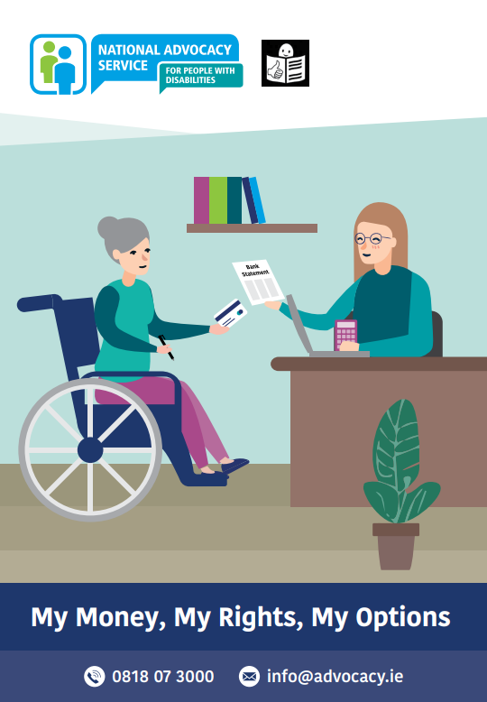
My Money, My Rights, My options
Easy to read doc on your rights

Slide 32
ADM(Capacity) Act and its impact on advocacy

Slide 33
Decision Making
Lunacy Regulation Act 1871
Ward of Court
Removal of all decision making rights (all or nothing approach)
Assisted Decision-Making (Capacity) Act 2015 (ADMA)
3 levels of decision-making supports
Person may need support with some decisions but not with others

Slide 34
Provisions of the ADMA
A new Decision Support Service (DSS) www.decisionsupportservice.ie
Repeal of the 1871 Act – All current Wards (2143) to be reviewed and within 3 years (Court).
A person may avail of a Decision-Making Assistant (DSS), a Co-Decision Maker (DSS) or a Decision-Making Representative (Court).
The Act also covers Advance Healthcare Directives and Enduring Powers of Attorney

Slide 35
Functional capacity
Is decision and time specific
Can the person understand the information relevant to the decision?
Can they retain the information long enough to make a choice?
Can they weigh up the information to inform their choice?
Can they communicate their choice? (does not need to be verbal)

Slide 36
Where does Independent Advocacy fit with Supported Decision Making & the ADM (Capacity) Act?

Slide 37

Decision Making Assistant
Co-Decision Maker
Decision Making Representative
Formal Decision-Making Support Options
Will and preference of the person
Notes:
NAS will continue to provide advocacy support to individuals as they currently do. However once the ADM is fully enacted some individuals may enter into these legally recognised decision making arrangements (1 & 2) or be appointed a decision making representative under the act (3). It will be important that advocates remain independent from that process so that any advocacy issues arising with decision support arrangements can be represented by an advocate, where a person chooses, without any conflict of interest.

Slide 38
Supporting the Will and Preference of Those with
Communication Differences
In a case where the person is not in a position to articulate their will or preferences the advocate
uses four internationally recognised approaches
to ascertain the person’s will and preference.
Person Centred Plans
Significant people in the person’s life e.g. family
PERSON CENTREDNESS
WITNESS OBSERVER
Information
From the person
RIGHTS BASED APPROACH
ORDINARY LIFE PRINCIPLES Eight Quality of Life Domains
Policy documents
Various Professionals

Slide 39
Advocacy Issues that have arisen for those with Decision Supporters under ADM that required advocacy support
A decision-making supporter is helping with decisions that are not included in the agreement
Where due process has not occurred (tokenism) – inappropriate capacity assessments
Where intervention has occurred but was unnecessary / prolonged
Where proportionality has not applied
Person’s right to unwise decisions is not being respected or coercion exists
Where misrepresentation of/over-riding of will & preference occurs
Ill treatment has occurred by decision making support person
Support to raise such complaint to the Decision Support Service where necessary

Slide 40
Ways NAS Advocates support the ADM Process
Support to person to understand the process. This includes ensuring relevant information is provided in a suitable way to the person.
Ensuring the person is aware of their rights and options depending on which ADM process is involved.
Assisting the relevant person to make their will and preference known regarding important matters. This could be their preference regarding having a decision making arrangement, or decisions such as who might take on the role of DMR.
Bringing focus to the Principles of the ADM in terms of decisions by services and others .
Encourage services to avail of supports such as ADM leads.
Ensuring the relevant person has access to legal support and support to the person (as with other legal processes) to engage with this.
Attending court with the person.
Support to the person with their engagement with co-decision makers or representative decision makers regarding decisions if required.

Slide 41
Common Challenges NAS advocates encounter
Services seeking to continue poor practices around supporting decision making by considering formal decision making supports as the only solution to resolving issues. Examples include where there has been conflict between family or services and one or other start looking at DRMO option to take control over decision making, which was never based on the person’s wishes or rights.
This can result also in decision making arrangements being considered for decisions that should be supported in less formal ways.
The opposite also happens where decision making arrangements are not being explored where they might really assist the person. This can be due to lack of knowledge and confidence by supporters.
Pre judgement and presumptions around capacity.
A hard transition in culture and thinking from blanket decision making to decision specific arrangements.
('we need a ward of court type arrangement'-quote from HSE decision maker very recently)
‘Appointments’ by the court and directives to produce court reports.
Varying levels of expertise between Legal Aid Hub and panel solicitors.

Slide 42
Challenges contd
Varying levels of knowledge and expertise among services/ professionals.
This can show up as lack of real belief in the concept of capacity and supporting decision making. It can be an unwillingness to explore ADM options due to lack of knowledge. Or it can be where there is an overconfidence about their understanding about what the ADM arrangements are, or more so what they think it should be.
This for example has shown up as attempts to introduce Co-Decision Making agreements as de facto representative decision making.
Issue of cost for a third party initiating a Capacity Application. This has resulted in extra considerations having to be given as to who will initiate the process. Also applicants more likely to seek future proofing orders while they are in the process which is against the principles of the ADM.
Also situation where duplicity in submitting an application from the relevant person-probably to avoid costs.

Slide 43
Sample NAS referrals
CASE 1: Solicitor contacted NAS Waterford to say they had been in court and the judge said that the relevant person needed independent representation where a Decision-Making Representation Order was being sought. The solicitor said that they needed a report for a court sitting in three weeks.
– Independence?
CASE 2: A man from Kerry was supported to contact NAS. He had a bank account with a ‘named carer’ from his service named on the account. This carer had left the service for a new job. When the man and his service approached the bank they were told another carer would need to be named and the account would be frozen until then.
– Presumption of Capacity?

Slide 44
CASE EXAMPLE-Shona
Shona is a young lady with autism who ended up very suddenly in an emergency out of home situation and requiring a residential placement. The advocate met with Shona many times and quickly identified that one of the biggest considerations and source of security for Shona was her day service. She didn’t mind not living with her family as long as she could continue her day service.
The HSE advised that the only option available would be an out of county placement and it was known that this was not what Shona wanted. Senior HSE professionals advised Shona's parents to get a Co Decision making arrangement in place so that they could make the decision that Shona should move to this placement.
Advocate sought to clarify the error of this information and also sought to establish Shona’s right to make her own decision around where she lives. It was fairly apparent that if the matter went to a court for a DMRO, that a functional capacity assessment would not support the order, which is presumably why a co decision making agreement was being put forward.
The advocate was able to establish that Shona did not want a Co-Decision Making Agreement, nor would she have wanted her parents to be Co Decision Makers.
Shona was also very clear that she would not consent to an out of county move.
Shona was eventually supported with an appropriate placement option that allowed her to continue to attend her day service.
It took some time after the move to ensure that Shona’s decision making rights were being upheld and also to keep challenging the narrative that her parents now held that they could arrange a Co-Decision making agreement and become decision makers.

Slide 45
Case example Brendan
Brendan has an Acquired Brain Injury. He is living somewhere inappropriate and unable to meet his needs.
An advocate has been working with Brendan about trying to arrange a move to somewhere more suitable.
In the middle of this his relative applied for a DMRO and applied to be a decision maker.
Brendan did not want a DMRO but would like assistance with decision making and has asked for a Co decision making agreement and not to have their relative involved. They selected someone else.
The Judge agreed to this and the advocate is now supporting the person to set up their Co Decision Making Agreement

Slide 46
CASE EXAMPLE: Margaret
Margaret has a history of mental health issues and is supported by the mental health services.
Margaret agreed to the sale of her home as she expects to never live there again as she is very happy with the residential house she is living in.
A DMRO was sought specifically to support Margaret around the large amount of money she was going to receive.
NAS was contacted to say that the Judge in the case wanted NAS to do a report.
The NAS advocate indicated they wouldn’t do a report but would complete an enquiry process.
The advocate was able to establish with Margaret that she was comfortable with the process. She herself identified that she would need support with managing such a large amount of money. The advocate was able to establish that Margaret had legal representation and also good support from her mental health team. She understood the various stages of the process. However she did have strong views on what she would like to use some of her money for. The advocate was able to complete a will and preference document outlining her wishes which included arrangements for her funeral(purchasing a burial plot) and prepaying her funeral. This was something she had not raised with anyone before. The advocate agreed to provide this list to the court to inform the DMR when appointed.
The advocate was able to advise Margaret on the role of the DMR and how important it is that her will and preference is considered. The advocate was able to explain the complaints process if Margaret is unhappy with how things are going and able to assure Margaret of the role of advocacy in assisting her if needed.

Slide 47
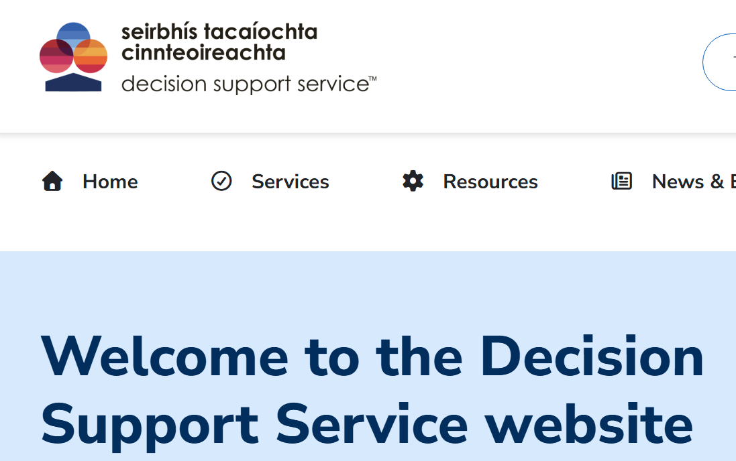
More Information on ADCMA (ADM)
Decision Support Service: Welcome to the Decision Support Service website | Decision Support Service

Slide 48
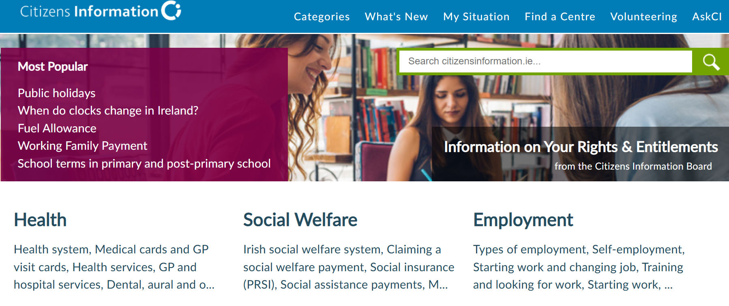
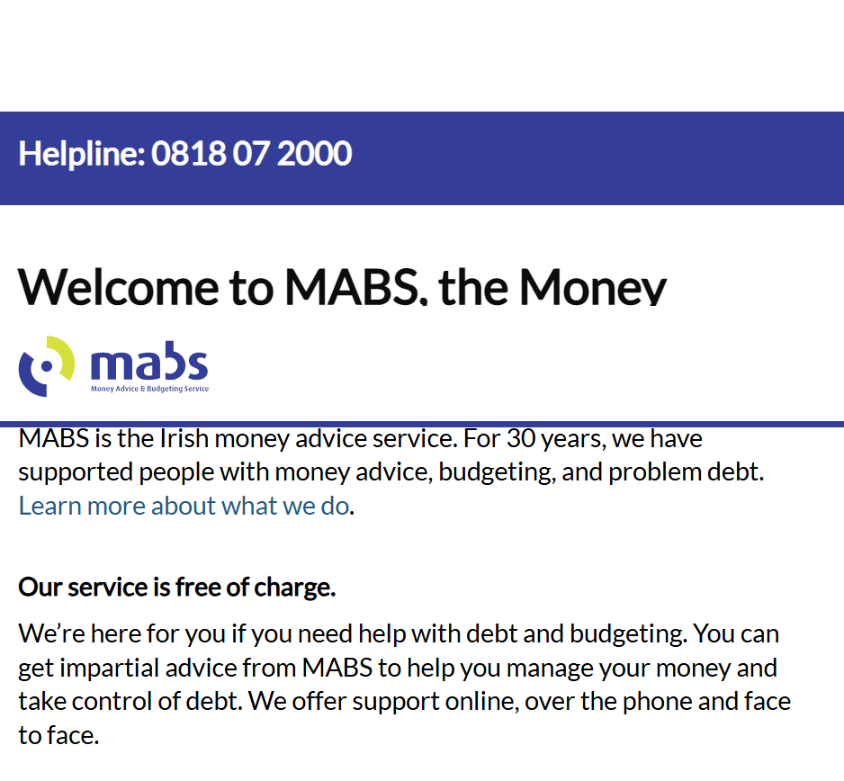
Supports around entitlements and budgeting supports
Citizens Information Service Home
MABS www.mabs.ie

Slide 49
Questions?

